Slide 1
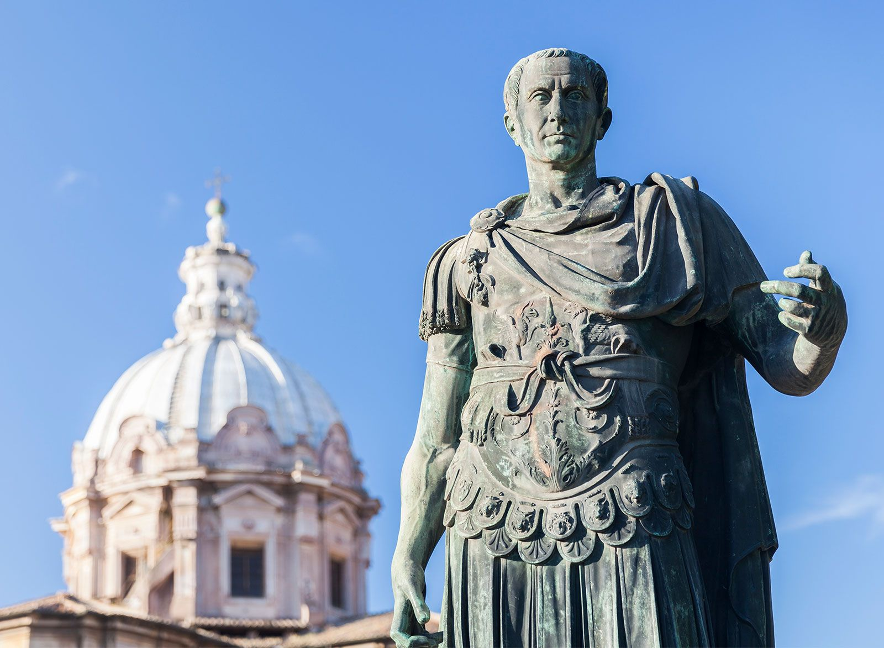
The First Triumvirate
- Define ‘Triumvirate’
- Identify the members of the First Triumvirate
Week 6 Lesson 3
Ms Barrie

Slide 2
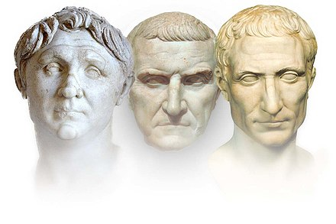
Triumvirate
Write the definition in your book
DEFINITION:
A political institution ruled or dominated by three individuals, known as triumvirs.
Can be formal or informal.
Though the three leaders in a triumvirate are ‘equal’, the actual distribution of power may vary.
TRY – UM – VI - RET
The Prefix ‘Tri’ means 3

Slide 3
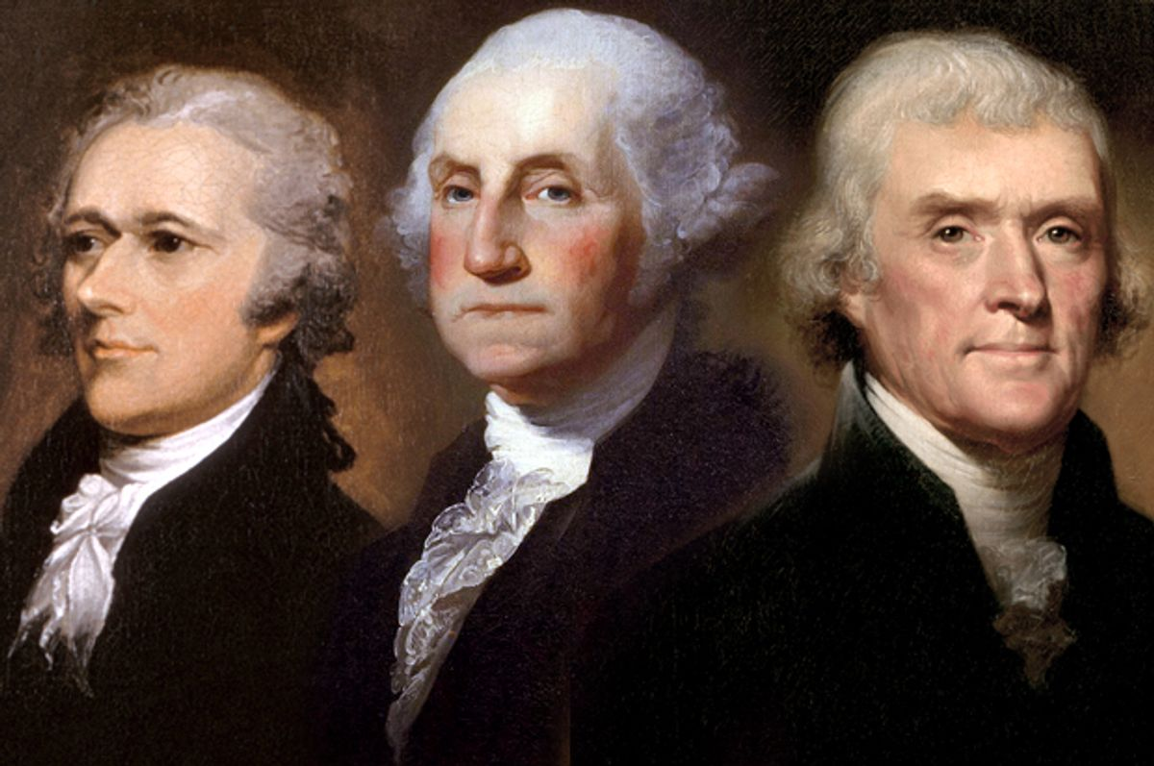
Modern Triumvirates
George Washington, Thomas Jefferson, and James Madison
Notes:
Founding Fathers who shaped America

Slide 4
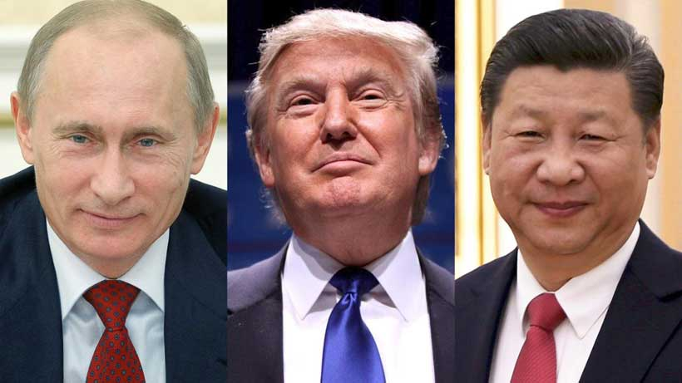
Modern Triumvirates
Putin, Trump and Jinping
Notes:
President of China

Slide 5
The First Triumvirate
https://www.youtube.com/watch?v=unerdc0Vrvo&ab_channel=SeeUinHistory%2FMythology

Slide 6
The First Triumvirate a secret political alliance between three politicians during the late Roman Republic. It was created in 60 BCE by Gaius Julius Caesar, Gnaeus Pompeius Magnus (known as Pompey 'the Great'), and Marcus Licinius Crassus. This alliance was designed to allow these three individuals to control the entire Roman political system in order to help each other achieve their own, individual, aims.

Slide 7
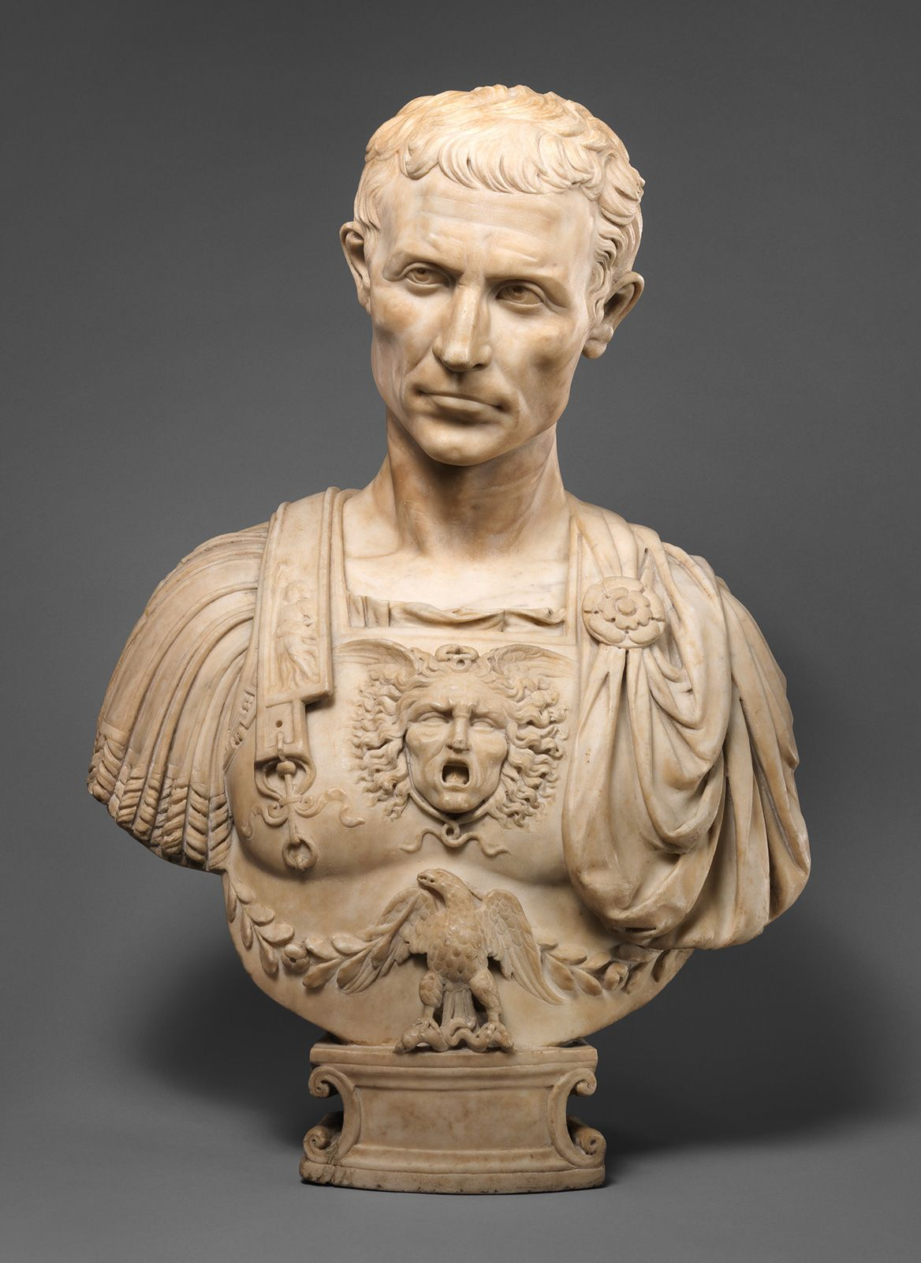
Gaius Julius Caesar
“The Greatest Dictator in Rome”

Slide 8
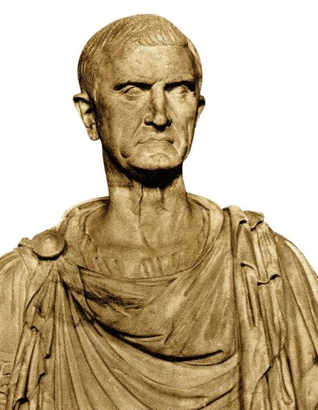
Marcus Licinius Crassus
“The Richest Man in Rome”

Slide 9
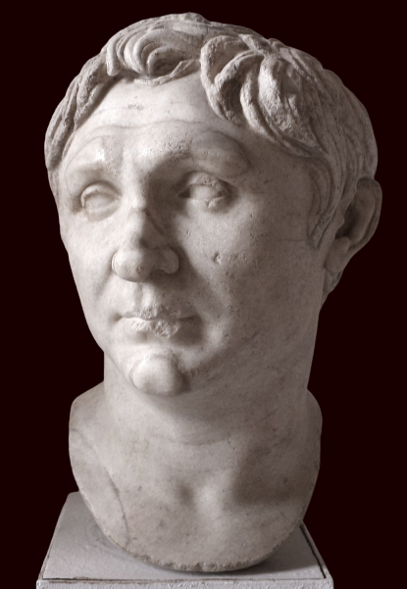
Gnaeus Pompeius Magnus
“Pompey The Great”

Slide 10
Background – Rome in 100’s BCE
Roman Republic in 1st century BCE = in trouble
Since Tiberius Gracchus in 133 BCE = political system increasingly under the power of wealthy and violent politicians.
Senate split into two competing factions:
Optimates: interested in maintaining the power traditional ruling class of Rome, who were the wealthy elites.
Populares: championed the causes of the common people.

Slide 11
Background – Rome in 100’s BCE
When one faction gained dominance/ majority in the Senate = other side would resort to powerful individuals who would resort to murder, violence, and even military invasions to swing the power balance back the other way.
50 years before the First Triumvirate was formed, each side had enjoyed dominance in the Senate at different times.
Populares: influence under the general Marius
Optimates gained control of the Senate as a result of the reforms by the general Sulla
However, by the beginning of 60 BCE, two powerful Roman politicians seemed to be strongly on the side of the populares, and they were Pompey and Caesar.
The optimate majority were concerned that they were about to lose power again and actively worked to limit the influence that these two men had in Roman politics.
When Pompey and Caesar began to realise that they were being openly opposed by the Senate, they realised that unless they could find a solution to their problems, they would never be allowed to progress their political careers any further.

Slide 12
ACTIVITY - Aims
Create a mind-map in your book of the 3 men and their aims

Slide 13
Gaius Julius Caesar
Gnaeus Pompeus Magnus
AIMS
Marcus Licinius Crassus

Slide 14
TEACHER ONLY – Pompey’s Aims
60 BCE, Pompey the Great was the most experienced and beloved military general alive - rose to prominence under Sulla's dictatorship, rocketed to fame and power through a series of remarkable military achievements.
Saved the city of Rome from the rebel consul Lepidus' revolt in 77 BC, defeated another rebel called Sertorius in the province of Spain in 73 BC, and had even helped crush the last elements of the Spartacus slave revolt in Italy in the same year. He became consul in 70 BC, cleared the Mediterranean of pirates in 67 BC, and had defeated the long-time enemy of Rome, Mithridates VI of Pontus in 64 BC.
While on this campaign in Asian Minor, in the eastern Mediterranean, Pompey had even managed to absorb Judaea into the Roman republic's sphere of control. So, when Pompey arrived back at Brundisium in Italy in 62 BC, he led an experienced army that was loyal to him alone.
Senate wondered – would he copy the example of Sulla when he had marched his army on Rome in 83 BC to seize power for himself. Surprisingly though, Pompey dismissed his army and travelled to Rome as a private citizen, not as a conquering commander.
Once in the city, the Senate awarded him another triumph the third of his life, for his eastern campaigns. However, as part of these celebrations, Pompey shared some of his new wealth with the common people by investing in new buildings and paid each of his loyal veteran soldiers 6000 sesterces (a Roman coin), which was worth over twelve years of wages.
Pompey's generosity made him even more popular with the people of Rome and made the Senate even more worried about his real motives. Therefore, when Pompey approached the Senate to get their official approval for his decision made during the campaign against Mithridates and Judaea, the Senate was looking for any opportunity they could to limit his power.
The Senate pointed out that Pompey had acted beyond the original instructions given to him: he hadn't had any authority to capture new territories or create new provinces in the east, all of which Pompey had done. What concerned Pompey the most was that he had promised his soldiers farmland when they retired.
However, since Pompey had technically acted outside of his authority, the Senate refused to grant these lands to Pompey's men. As a result, Pompey now had thousands of disappointed and angry soldiers on the streets of Rome who had trusted him to fulfil his promise.
Consequently, Pompey had to find a solution to get the land he had promised to his men despite the fact that the Senate was hostile to the idea.

Slide 15
TEACHER ONLY – Crassus’ Aims
. In 60 BC, he was about 55 years and was the richest individual in Rome. While Crassus had had some military roles during his career, he spent most of his time in the business world, making a financial profit.
Crassus made a lot of wealth during the proscriptions of Sulla, where, it was rumoured, that he had put names of his personal enemies on the list of names, and then had them killed in order to seize their assets. Using his sudden influx of wealth, Crassus then manipulated the sale of houses and buildings in Rome, forcing people to sell them for less than they were worth.
During this time, Crassus was able to form powerful connections with other Roman businessmen, from the equites class, who relied upon him for personal and business loans. Some of these men were tax-collectors.
They had gotten themselves in trouble by bidding too high on government tax contracts and they were suddenly unable to pay money back either to the Senate or to Crassus.
These men approached Crassus and asked for help. Crassus wanted his money back and refused to free them from their debts to him.
However, as long as the Senate also refused to let them get out of their tax contracts, these men would never be able to pay Crassus either.
As a result, Crassus approached the Senate to ask for the tax contracts to be reduced.
Just as the Senate was worried about Pompey's popularity, it was also worried about Crassus economic power.
And, just as they actively opposed Pompey, they also opposed Crassus and refused to honour his request.
So, in 60 BCE, Crassus was looking for some way to get around the Senate's refusal to cooperate.
He ideally wanted someone in the Senate who would support his request: someone with enough power and influence to overturn their hostility to him.

Slide 16
TEACHER ONLY – Caesar’s Aims
In 60 BC, Gaius Julius Caesar was the youngest of the three men, at about 40 years old. He had just returned to Rome from a successful military campaign in Spain. Caesar had achieved the requirements to celebrate his first triumph. However, he was also seeking to be elected as one of the consuls for the next year 59 BC.
The Senate, who was worried that he was another populares politician who could cause them concern gave him an ultimatum: either have a triumph or stand for election. This was an unfair demand, but the Senate assumed that Caesar would take the triumph, as Romans went their entire careers in the hope of getting just one triumph.
However, Caesar shocked the Senate by giving up the triumph and choosing to contest the consular election instead.
However, Caesar knew that his chances of becoming consul were small because he did not have the same level of popular with the people of Rome as other potential candidates.
Caesar needed to work hard to convince the citizens to vote for him. In Roman political terms, this usually required a lot of bribery: offering monetary incentives for people to vote for him over his rivals.
While bribery is considered a form of corruption in modern political terms, it was entirely acceptable in ancient Rome.
In fact, most people seeking election in Rome often went into significant debt to be elected, knowing that by gaining a position could mean making enough money to pay back their debts.
Caesar himself did not have enough money to pay the amount required to bribe enough voters.
In order to raise the funds necessary, he had to find a financial supporter. Before he had begun his previous campaign in Spain, Caesar had relied upon a loan from Crassus, so it was natural that he might turn to him again in this instance.

Slide 17

How was the alliance formed?
Each of the three men faced unsurmountable challenges that could not be resolved alone.
Their difficulties were public knowledge and there was significant tension in Rome about what would happen.
However, it was Julius Caesar who realised that the three men could actually use their individual strengths to help each other out.
In 60 BC, Caesar invited Crassus and Pompey to a secret meeting. Since this discussion was secret, the exact details of what was decided is unknown.
However, based upon what would happen over the next two years, historians can confidently identify the terms of their agreement.
Caesar promised that, if he became consul, he would ensure that legislation would be enacted that would solve both Crassus' and Pompey's problems.
In return, he needed Crassus' money to pay for votes and Pompey's soldiers to intimidate voters on the day to ensure Caesar won.
The most difficult part of this agreement was the fact that Pompey and Crassus hated each other.
Ever since Pompey had unfairly stolen Crassus' triumph at the end of the Spartacus revolt, the two men had been direct opponents.
However, Caesar was able to encourage the two to overlook their personal animosities in order to work together.
Once the agreement had been reached, the three men knew that what they were doing was considered highly illegal in Roman politics and the three men swore to keep their arrangement secret for as long as they could.

Slide 18

Summary
Describe the aims of each individual in 10 words or less per/person

